Slide 1
Graph unit-4

Slide 2
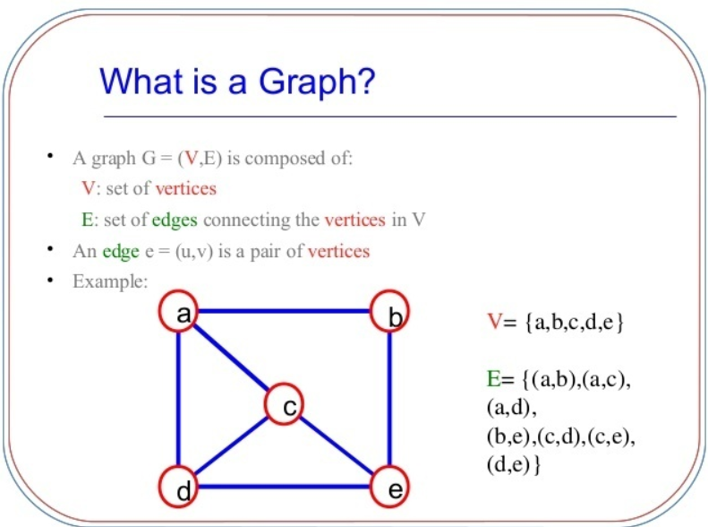

Slide 3
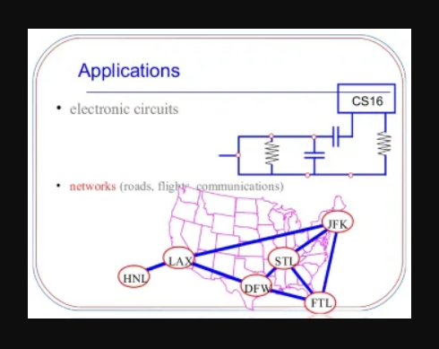

Slide 4
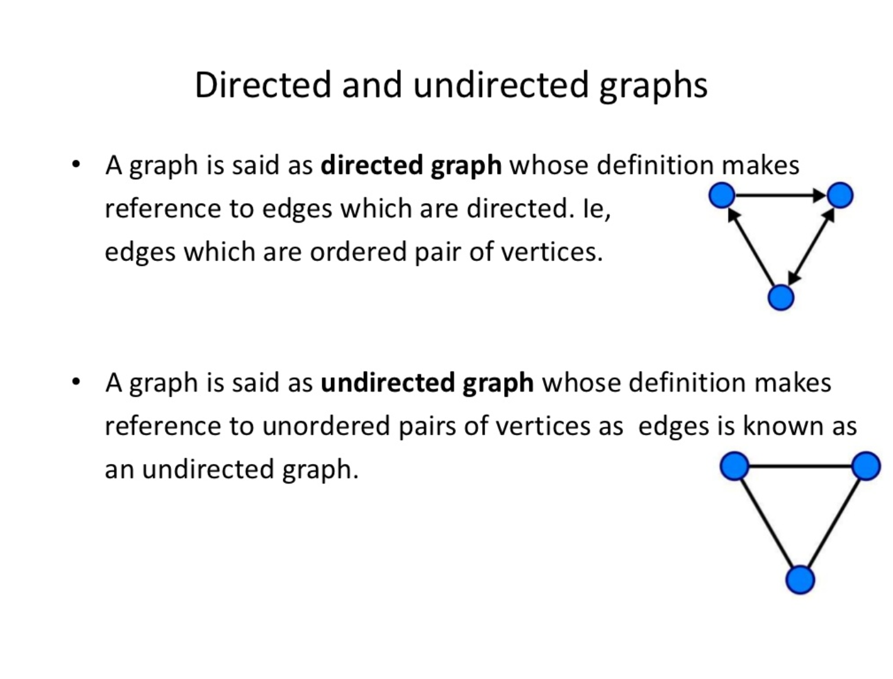
Graph terminologies:

Slide 5
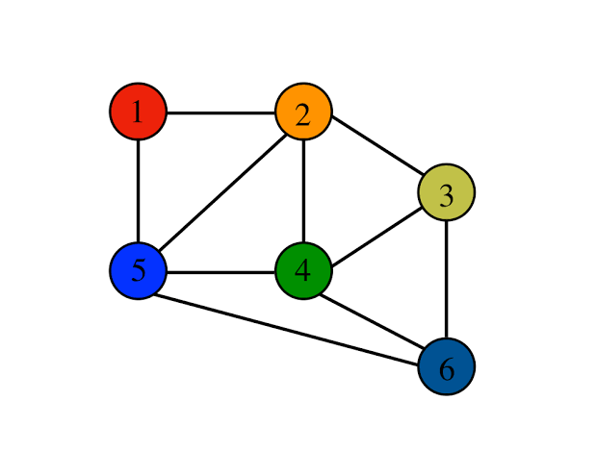
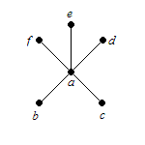
Graph Terminology
Adjacent vertices:vertices connected by an edge
Degree:number of adjacent vertices(no. of edges incident to that vertex)
End vertices:#degree=1

Slide 6
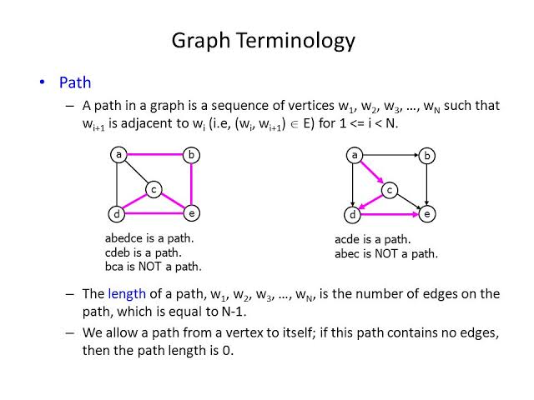

Slide 7
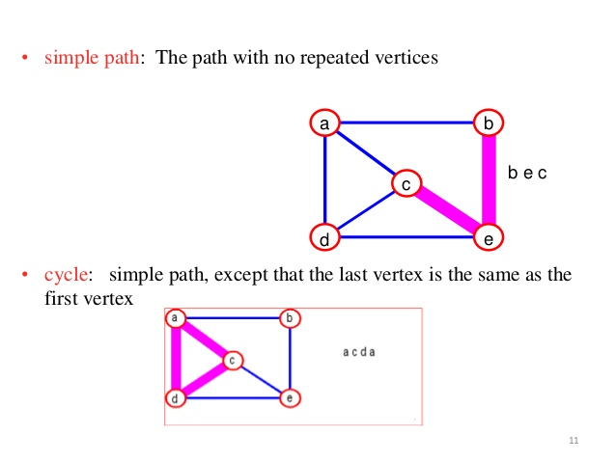

Slide 8
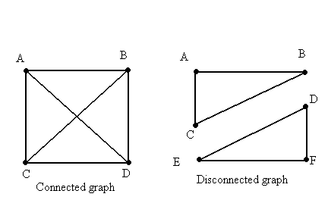
Graph terminology
Connected graph:any two vertices are connected by some path

Slide 9
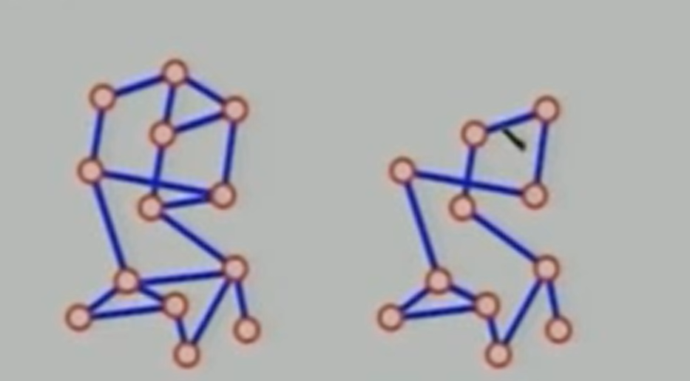
Graph terminologies
Sub graph: subset of vertices and edges forming a graph

Slide 10
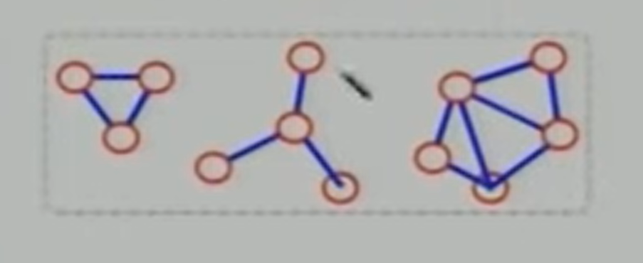
Graph Terminologies
Connected component:maximal(can’t increase size and retain property) connected subgraph

Slide 11
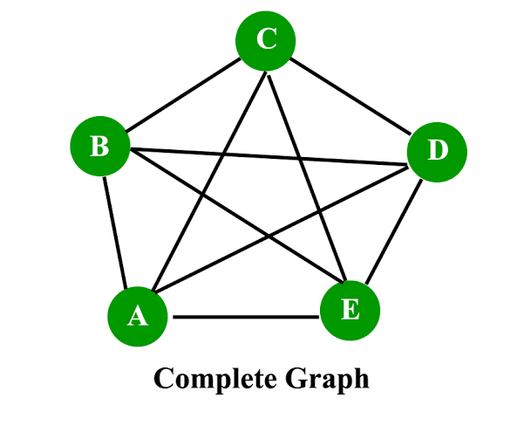
Graph Terminologies
Complete graph:all pair of vertices are adjacent
Q.)how many edges
does a complete grap
have?[n(n-1)/2]
Q.)how many edges
Does a complete
Directed graph
have?

